Slide 1
Object Oriented Programming Design
SESSION 15 Date : 18-01-2025

Slide 2
Object Class, Wrapper classes, Type inquiry, Object equality and cloning

Slide 3
Object Class
The Object class is the super class of all the classes in java by default. This means that it is the topmost class of java.
The Object class is beneficial if we want to refer any object whose type we don't know.
The parent class reference variable can refer the child class object, know as upcasting.
Consider an example, there is getObject() method that returns an object but it can be of any type like Employee, Student etc, we can use Object class reference to refer that object.
For example:
Object obj=emp1.getObject();//we don't know what object will be returned from this method
The Object class provides some common behaviors to all the objects such as object can be compared, object can be cloned, object can be notified etc.
Object Oriented Programming

Slide 4
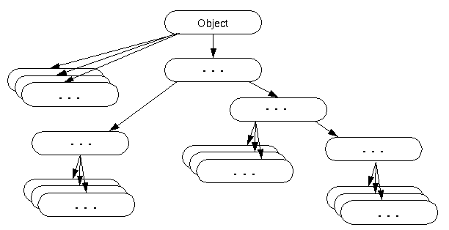
Object Class
Object Oriented Programming

Slide 5
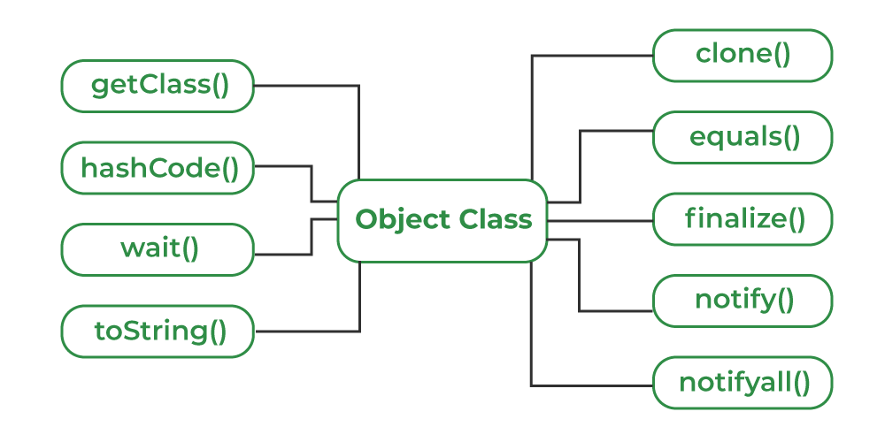
Object Class methods
Object Oriented Programming

Slide 6
Object Class
Methods of Object class
Method | Description
public final Class getClass() | returns the Class class object of this object. The Class class can further be used to get the metadata of this class.
public boolean equals(Object obj) | compares the given object to this object.
protected Object clone() throws CloneNotSupportedException | creates and returns the exact copy (clone) of this object.
public String toString() | returns the string representation of this object.
public final void notify() | wakes up single thread, waiting on this object's monitor.
public final void notifyAll() | wakes up all the threads, waiting on this object's monitor.
Object Oriented Programming

Slide 7
Object Class
Method | Description
public final void wait(long timeout)throws InterruptedException | causes the current thread to wait for the specified milliseconds, until another thread notifies (invokes notify() or notifyAll() method).
public final void wait(long timeout,int nanos)throws InterruptedException | causes the current thread to wait for the specified milliseconds and nanoseconds, until another thread notifies (invokes notify() or notifyAll() method).
public final void wait()throws InterruptedException | causes the current thread to wait, until another thread notifies (invokes notify() or notifyAll() method).
protected void finalize()throws Throwable | is invoked by the garbage collector before object is being garbage collected.
Object Oriented Programming

Slide 8
Object Class
Thread Synchronization in Java
In a multithreaded environment, multiple threads might try to modify the same resource.
If threads aren't managed properly, this will, of course, lead to consistency issues
One tool we can use to coordinate actions of multiple threads in Java – is guarded blocks.
Such blocks keep a check for a particular condition before resuming the execution.
With that in mind, we'll make use of:
  Object.wait() – to suspend a thread
  Object.notify() – to wake a thread up
This can be better understood from the following diagram, that depicts the lifecycle of a Thread:
Object Oriented Programming

Slide 9
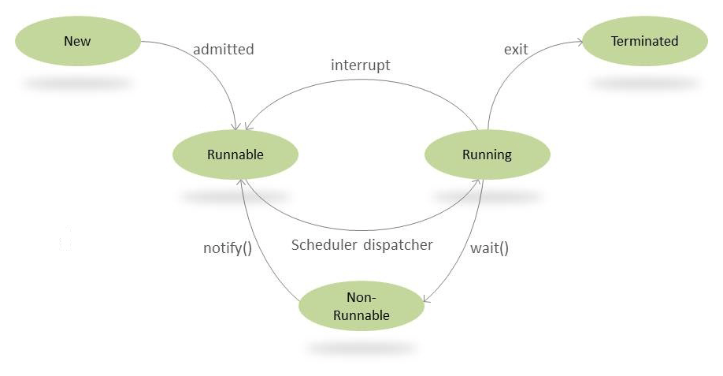
Object Class
Object Oriented Programming

Slide 10
Object Class
There are many ways of controlling thread lifecycle;
Using wait() and notify() is one among the several ways.
wait() method
Simply put, when we call wait() – this forces the current thread to wait until some other thread wants to complete.
For this, the current thread must own the object's monitor.
A thread can become the owner of the object in three ways:
By executing a synchronized instance method of that object.
By executing the body of a synchronized statement that synchronizes on the object.
For objects of type Class, by executing a synchronized static method of that class.
Object Oriented Programming

Slide 11
Object Class
Note that only one active thread can own an object's monitor at a time.
This wait() method comes with three overloaded signatures. Let's have a look at these.
wait()
The wait() method causes the current thread to wait indefinitely until another thread either invokes notify() for this object or notifyAll().
wait(long timeout)
Using this method, we can specify a timeout after which thread will be woken up automatically.
A thread can be woken up before reaching the timeout using notify() or notifyAll().
Note that calling wait(0) is the same as calling wait().
Object Oriented Programming

Slide 12
Object Class
wait(long timeout, int nanos)
This is yet another signature providing the same functionality, with the only difference being that we can provide higher precision.
The total timeout period (in nanoseconds), is calculated as 1_000_000*timeout + nanos.
notify() and notifyAll()
The notify() method is used for waking up threads that are waiting for an access to this object's monitor.
For all threads waiting on this object's monitor (by using any one of the wait() method), the method notify() notifies any one of them to wake up arbitrarily.
The choice of exactly which thread to wake is non-deterministic and depends upon the implementation.
Object Oriented Programming

Slide 13
Object Class
Since notify() wakes up a single random thread it can be used to implement mutually exclusive locking where threads are doing similar tasks, but in most cases, it would be more viable to implement notifyAll().
notifyAll()
This method simply wakes all threads that are waiting on this object's monitor.
The awakened threads will complete in the usual manner – like any other thread.
But before we allow their execution to continue, always define a quick check for the condition required to proceed with the thread – because there may be some situations where the thread got woken up without receiving a notification.
Object Oriented Programming

Slide 14
Wrapper classes
As the name suggests, wrapper classes are objects encapsulating primitive Java types.
Each Java primitive has a corresponding wrapper:
  boolean, byte, short, char, int, long, float, double
  Boolean, Byte, Short, Character, Integer, Long, Float, Double
These are all defined in the java.lang package, hence we don't need to import them manually.
Wrapper class provides various methods which we can use with collections like sorting, searching.

Slide 15
Wrapper classes
Why Wrapper classes?
Basically, generic classes only work with objects and don't support primitives.
As a result, if we want to work with them, we have to convert primitive values into wrapper objects.
For example, the Java Collection Framework works with objects exclusively.
Earlier it was not possible to simply call add(5) on a collection of Integers.
Primitive values needed to be manually converted to corresponding wrapper classes and stored in collections.
But now with autoboxing, we can easily do ArrayList.add(101) but internally Java converts the primitive value to an Integer before storing it in the ArrayList using the valueOf() method.

Slide 16
Wrapper classes
Primitive to Wrapper Class Conversion
How do we convert a primitive value to a corresponding wrapper class.
E.g. an int to Integer or a char to Character?
We can either use constructor or static factory methods to convert a primitive value to an object of a wrapper class.
Example of converting an int value to an Integer object in Java:
  Integer object = new Integer(1);
  Integer anotherObject = Integer.valueOf(1);
The valueOf() method returns an instance representing the specified int value.

Slide 17
Wrapper classes
Similarly, we can also convert boolean to Boolean, byte to Byte, char to Character, long to Long, float to Float, and double to Double.
Though if we have to convert String to Integer then we need to use parseInt() method because String isn't a wrapper class.
Converting Wrapper object to Primitive type
On the other hand, to convert from a wrapper object to a primitive value, we can use the corresponding method such as intValue(), doubleValue() etc:
int val = object.intValue();

Slide 18
Wrapper classes
Autoboxing and Unboxing
“Boxing” refers to converting a primitive value into a corresponding wrapper object.
Because this can happen automatically, it's known as autoboxing.
Similarly, when a wrapper object is unwrapped into a primitive value then this is known as “unboxing”.
Auto Boxing:
List<Integer> list = new ArrayList<>(); list.add(1); // autoboxing
Integer val = 2; // autoboxing

Slide 19
Wrapper classes
In this example, Java will automatically convert the primitive int value to the wrapper.
Internally, it uses the valueOf() method to facilitate the conversion.
For example, the following lines are equivalent:
Integer value = 3;
Integer value = Integer.valueOf(3);
Though this makes conversion easy and codes more readable, there are some cases where we shouldn't use autoboxing e.g. inside a loop.

Slide 20
Wrapper classes
Unboxing
Similar to autoboxing, unboxing is done automatically when passing an object to a method that expects a primitive or when assigning it to a primitive variable:
Integer object = new Integer(1);
int val1 = getSquareValue(object); //unboxing
int val2 = object; //unboxing
public static int getSquareValue(int i) {
return i*i; }
Note: if we write a method that accepts a primitive value or wrapper object, we can still pass both values to them.
Java will take care of passing the right type e.g. primitive or wrapper depending upon context.

Slide 21
Wrapper classes
class WrapperDemo {
public static void main(String[] args) {
int a = 5; // create primitive types
double b = 5.65;
Integer aObj = Integer.valueOf(a); //converts into wrapper objects
Double bObj = Double.valueOf(b);
if(aObj instanceof Integer) {
System.out.println("An object of Integer is created.");
}
if(bObj instanceof Double) {
System.out.println("An object of Double is created.");
}
}
}

Slide 22
Wrapper classes
However, the Java compiler can directly convert the primitive types into corresponding objects.
For example,
int a = 5;
// converts into object
Integer aObj = a;
double b = 5.6;
// converts into object
Double bObj = b;

Slide 23
Java Types and Type inquiry
Type: set of values and the operations that can be applied to the values
Strongly typed language: compiler and run-time system check that no operation can execute that violates type system rules
Compile-time check
Employee e = new Employee();
e.clear(); // ERROR
Run-time check:
e = null;
e.setSalary(20000); // ERROR

Slide 24
Java Types and Type inquiry
Java Types
Primitive types: int, short, long, byte, char, float, double, boolean
Class types, Interface types, Array types, The null type
Note: void is not a type
Example: What kind of type?
int
Rectangle
Shape
String[]
double[][]

Slide 25
Java Types and Type inquiry
Java Values
value of primitive type
reference to object of class type
reference to array
Null
Example: What kind of value?
13
new Rectangle(5, 10, 20, 30);
"Hello"
new int[] { 2, 3, 5, 7, 11, 13 }
null
Note: Can't have value of interface type. Why?

Slide 26
Java Types and Type inquiry
Subtype Relationship - Rules
S is a subtype of T if
S and T are the same type
S and T are both class types, and T is a direct or indirect superclass of S
S is a class type, T is an interface type, and S or one of its superclasses implements T
S and T are both interface types, and T is a direct or indirect superinterface of S
S and T are both array types, and the component type of S is a subtype of the component type of T
S is not a primitive type and T is the type Object
S is an array type and T is Cloneable or Serializable
S is the null type and T is not a primitive type

Slide 27
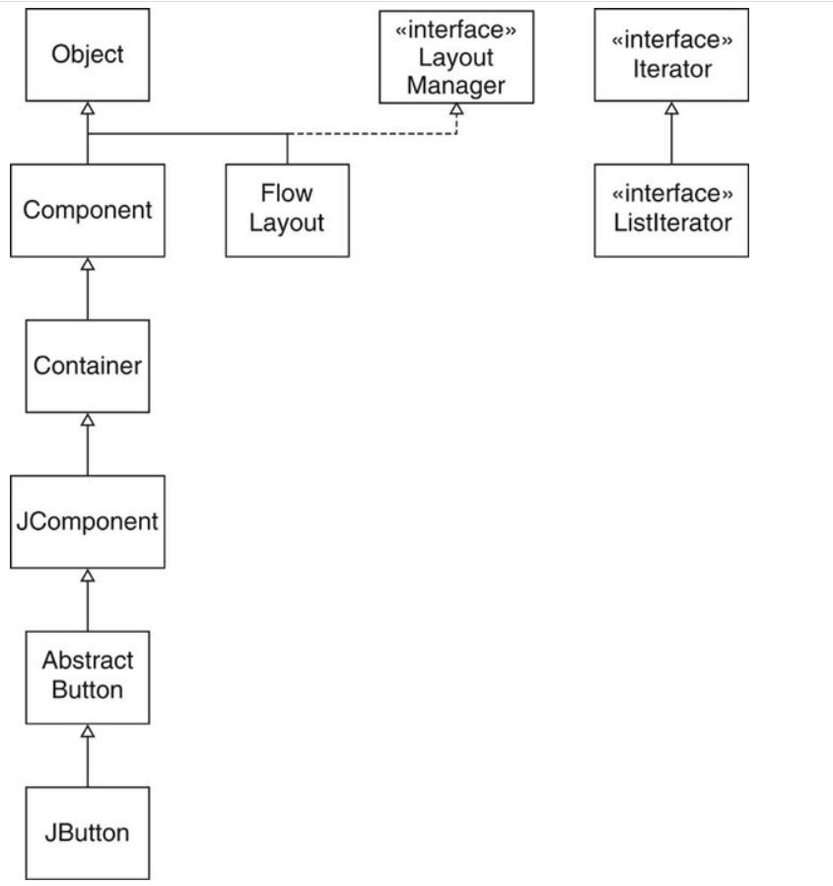
Java Types and Type inquiry
Container is a subtype of Component
JButton is a subtype of Component
FlowLayout is a subtype of LayoutManager
ListIterator is a subtype of Iterator

Slide 28
Java Types and Type inquiry
More Subtype Examples
Rectangle[] is a subtype of Shape[]
int[] is a subtype of Object
int is not a subtype of long
long is not a subtype of int
int[] is not a subtype of Object[]

Slide 29
Java Types and Type inquiry
Type Inquiry
Test whether e is a Shape:
if (e instanceof Shape) . . .
Common before casts:
Shape s = (Shape) e;
Don't know exact type of e
Could be any class implementing Shape
If e is null, test returns false (no exception)
Type Inquiry with instanceof operator
Test whether e is a Rectangle:
if (e.getClass() == Rectangle.class) . . .
Ok to use ==
A unique Class object for every class
Test fails for subclasses
Use instanceof to test for subtypes:
if (e instanceof Rectangle) . . .

Slide 30
Java Types and Type inquiry
The equals Method
equals tests for equal contents
== tests for equal location
Used in many standard library methods
Example: ArrayList.indexOf
The following example Searches for the first occurrence of the given argument, testing for equality using the equals method.
@param elem an object.
@return the index of the first occurrence of the argument in this list;
returns -1 if the object is not found.

Slide 31
Java Types and Type inquiry
public int indexOf(Object elem)
{
if (elem == null)
{
for (int i = 0; i < size; i++)
if (elementData[i] == null) return i;
}
else
{
for (int i = 0; i < size; i++)
if (elem.equals(elementData[i])) return i;
}
return -1;
}

Slide 32
Object equality and cloning
Object Cloning in Java
The object cloning is a way to create exact copy of an object.
The clone() method of Object class is used to clone an object.
The java.lang.Cloneable interface must be implemented by the class whose object clone we want to create.
If we don't implement Cloneable interface, clone() method generates CloneNotSupportedException.
The clone() method is defined in the Object class.

Slide 33
Object equality and cloning
Why use clone() method instead of new operator?
The clone() method saves the extra processing task for creating the exact copy of an object.
If we perform it by using the new keyword, it will take a lot of processing time to be performed that is why we use object cloning.

Slide 34
Object equality and cloning
Advantage of Object cloning
You don't need to write lengthy and repetitive codes.
Just use clone() method.
It is the easiest and most efficient way for copying objects, especially if we are applying it to an already developed or an old project.
Just define a parent class, implement Cloneable in it, provide the definition of the clone() method and the task will be done.
For example Clone() is the fastest way to copy array.

Slide 35
Object equality and cloning
Disadvantage of Object cloning
Following is a list of some disadvantages of clone() method:
To use the Object.clone() method, we have to change a lot of syntaxes to our code, like implementing a Cloneable interface, defining the clone() method and handling CloneNotSupportedException, and finally, calling Object.clone() etc.
We have to implement cloneable interface while it doesn't have any methods in it. We just have to use it to tell the JVM that we can perform clone() on our object.

Slide 36
Object equality and cloning
Disadvantage of Object cloning
Object.clone() is protected, so we have to provide our own clone() and indirectly call Object.clone() from it.
Object.clone() doesn't invoke any constructor so we don't have any control over object construction.
If you want to write a clone method in a child class then all of its superclasses should define the clone() method in them or inherit it from another parent class. Otherwise, the super.clone() chain will fail.
Object.clone() supports only shallow copying but we will need to override it if we need deep cloning.

Slide 37
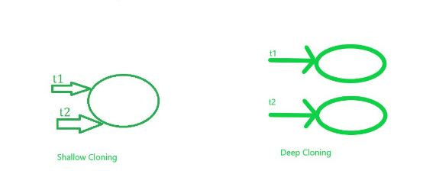
Object equality and cloning
Shallow and Deep copy in cloning
Methods of Copying Objects in Java
Copying can be of three types as follows:
Shallow copy
Deep copy
Cloning
Where deep copy and cloning is referred to as the same deep cloning

Slide 38
Object equality and cloning
1. Shallow Copy/ Cloning
Default implementation while using the clone() method a shallow copy of the object is created.
It means it creates a new instance and copies all the fields of the object to that new instance where both are referencing to the same memory in heap memory.
If the object contains primitive as well as non-primitive or reference type variable in shallow copy, the cloned object also refers to the same object to which the original object refers as only the object references get copied and not the referred objects themselves.
In simpler terms, One object is being created here while two references in the stack memory.
It returns it as an object type, we need to explicitly cast it back to our original object. This is a shallow copy of the object.

Slide 39
Object equality and cloning
2. Deep copy/ cloning
It is the process of creating exactly the independent duplicate objects in the heap memory and manually assigning the values of the second object where values are supposed to be copied is called deep cloning.
For the deep copy, it needs to ensure that all the member classes also implement the Cloneable interface because of overriding the clone() method of the object class.

Slide 40
Object equality and cloning
Difference between Deep and Shallow Copy
CloneDemo.java for demonstrating Deep and Shallow copy CloneDemo.java
Shallow Copy | Deep Copy
It is fast as no new memory is allocated. | It is slow as new memory is allocated.
Changes in one entity is reflected in other entity. | Changes in one entity are not reflected in changes in another identity.
The default version of the clone() method supports shallow copy. | In order to make the clone() method support the deep copy, one has to override the clone() method.
A shallow copy is less expensive. | Deep copy is highly expensive.
Cloned object and the original object are not disjoint. | Cloned object and the original object are disjoint.

Slide 41
Thanks

